Slide 1
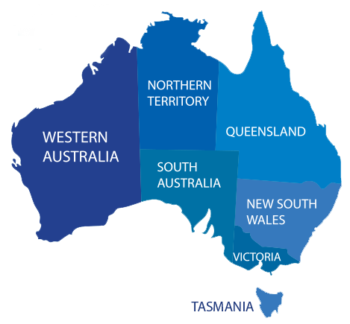
Which city is Australia’s next property hotspot ?
?
Migration at record high
Supply of housing is limited
Affordability of properties
Uncertainty about property prices

Slide 2
Forecasting model
DATA
ARIMA
+
RANDOM FOREST
FORECAST
ARIMA captures city level property price trends
Random Forest spot hidden patterns like inflations’ effect on house prices
Smarter, sharper, reliable model

Slide 3

From Forecast to Action
Identify the most expensive markets
Identify the growth opportunities in the market
Insights that guide smarter investment, planning, development
Let’s explore how this model could support investment strategies
and policy planning

